Slide 1






1UP: Empowering Communities with APIs
Michael Irigoyen
Senior Software Engineer mirigoyen@accusoft.com
goyney
mririgo

Slide 2



Who is Accusoft?
Accusoft is a software development company specializing in content processing, conversion, and automation solutions.
Notes:
From out-of-the-box and configurable applications to APIs built for developers, we help organizations solve their most complex content workflow challenges. Our solutions enable users to gain insights from content in any format, on any device, with greater efficiency, flexibility, and security.

Slide 3


28 Years of Innovation… and Counting.
Our Legacy, Your Future.
Notes:
Accusoft has been at the forefront of the document and imaging industry for more than two decades. Backed by 40 patents and an extensive catalogue of IP, we are dedicated to continuous innovation through customer-centric product development, new version release, and a passion for understanding industry trends that drive consumer demand.

Slide 4
Accusoft’s Mission
Our mission is to make the world in which we live and work a better place. We do this by inventing new ways to help organizations become more efficient and innovative, promoting the continuous improvement of our community, and working to minimize our impact on natural resources.
Our mission is to make the world in which we live and work a better place. We do this by inventing new ways to help organizations become more efficient and innovative, promoting the continuous improvement of our community, and working to minimize our impact on natural resources.

Slide 5




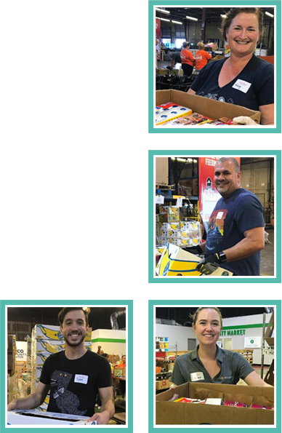
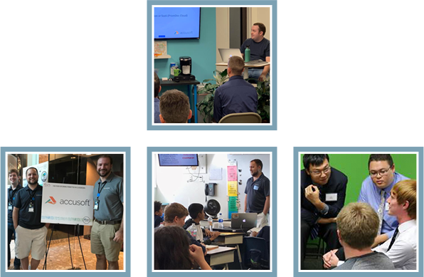
Notes:
We volunteer our time to educate the community, to help those affected by natural disasters, to help people and animals in need, to bring gifts and supplies to children, and by bringing college students for hands-on, paid internships.

Slide 6



Notes:
Started in 2008 in memory of a young girl named Victoria who lost her battle with cancer 3 times, Extra Life has rasied over $50 million since its inception. 100% of the funds raised go directly to Children’s Miracle Network hospitals, where they’re free to use the money to fund research/training, purchase life-saving equipment, and pay for uncompensated care. Voluneteers also frequent their local CMNH to donate games and their time with children in the hospitals care.

Slide 7
Accusoft Does Extra Life
Started participating in 2017
Company-wide game day and marathon
Raised over $6000 first two years
Hope to raise at least $4000 this year

Slide 8
Embracing our Tech Culture
We want to create ways to bring more exposure to the charity
Employ Extra Life’s REST API to drive tools
Display fundraiser status on…

Slide 9






WordPress
Twitch
Slack
JavaScript
React
Node.js

Slide 10
Staying DRY
Instead of implementing REST calls three times, develop a JavaScript wrapper
Needs to support:
Browser - ES Module
Browser - Client-Side
Node.js

Slide 11
Additional Goals
Single code base that builds for all three
Lightweight; no external dependencies
Published to NPM

Slide 12
Distribution
main - CommonJS code
module - ES code
browser - Client-side code
Replaces the “main” entrypoint
"main": "dist/main.js",
"module": "dist/module.js",
"browser": {
"./dist/main.js": "./dist/extra-life.js"
}
Notes:
Any Node dev is familiar with “main.” “module” is in proposal phase, but widely used by most bundles and is likely to be accepted. “browser” allows you to replace the entire “main” entrypoint, or cherry specific files to override for client-side use.

Slide 13

Generating Our Module
Rollup.js
Create multiple builds from same source with different configs
JSCC
Create conditional inclusion/exclusion blocks based on compile-time variables
Notes:
Rollup is lightweight and super easy to configure for what this project entails, so it was chose over webpack.

Slide 14
Browser
Fetch
Main
Entrypoint
GET
Wrapper
Returns Promises
Node
Requests
/* #if _BROWSER
import get from './browser';
//#else */
import get from './node';
// #endif
export default get;
Notes:
Main entry exports our API interface. GET Wrapper uses conditionals to include either browser-friendly “fetch” or use Node’s HTTPS module to make the REST calls.

Slide 15
Rollup Config
const node = {
input: 'src/main.js',
output: {
file: pkg.main,
format: 'cjs',
interop: false
},
external: ['https'],
};
const browser = {
input: 'src/main.js',
output: [
{
file: pkg.module,
format: 'esm',
sourcemap: true
},
{
file: pkg.browser[`./${pkg.main}`],
format: 'iife',
name: 'extraLife',
sourcemap: true
}
],
plugins: [
jscc({
values: { _BROWSER: true }
})
]
};
Setting the _BROWSER value in the JSCC plugin uses the browser code in our GET wrapper
Generate CommonJS for Node, ESM for React, and IIFE for Client-Side
IIFE (Immediately Invoked Function Expression) runs the moment it is defined
The IIFE code registers a global extraLife variable for API use

Slide 16
Using the Extra Life Module
Node
const extraLife = require('extra-life');
extraLife.getTeam(45209).then(console.log);
Browser
<script src="path/to/extra-life.js"></script>
<script>
extraLife.getTeam(45209).then(console.log);
</script>
React
import { getTeam } from 'extra-life';
getTeam(45209).then(console.log);
Notes:
Produces similiar interfaces for each integration that can be used in Promise or async/await notation.

Slide 17
Get the Extra Life Module
Source code and examples available on GitHub
https://github.com/goyney/extra-life
Install it from NPM
npm install extra-life
yarn add extra-life

Slide 18
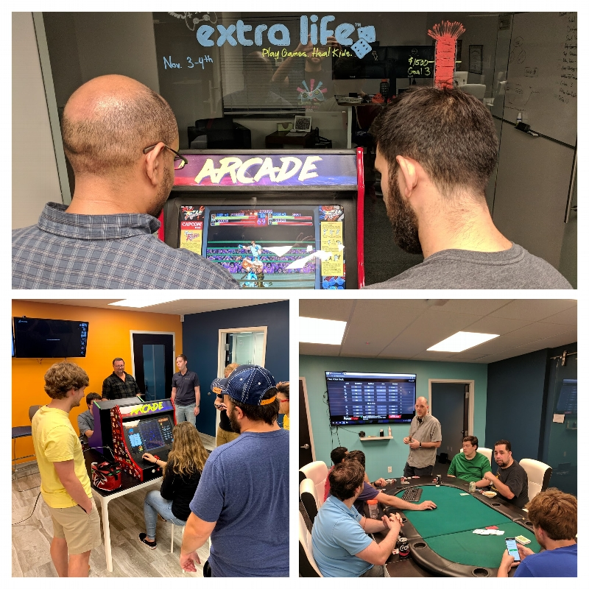
Help us in our quest to heal sick children!
accusoft.com/extralife

Slide 19
Michael Irigoyen
Senior Software Engineer mirigoyen@accusoft.com
goyney
mririgo

